Slide 1

EMBEDDED SOFTWARE FOR IOT
PRESENTATION
Bortolon Matteo - Bouveret Samuele

Slide 2
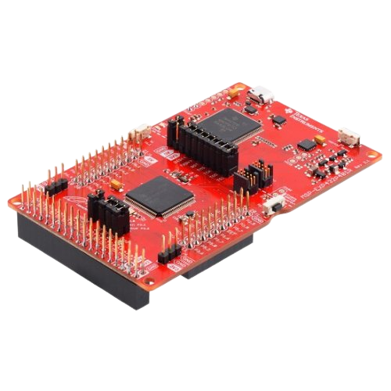
WEATHER APP
Application that shows city and room temperature and weather type of various world cities
API to retrieve data
LCD screen to display information
Using MSP432 combined with the Boosterpack MKII and the CC3100 Wi-Fi module from TI

Slide 3
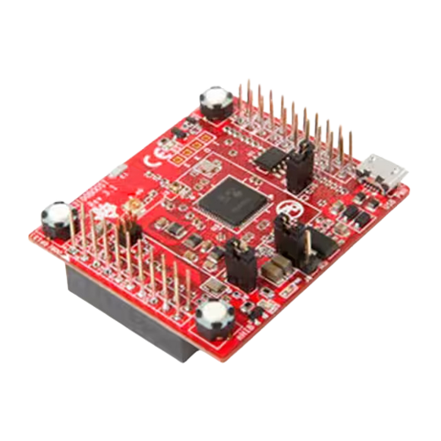
Part 1: CC3100
CC3100
Used API
Request setup
API response
Is a Wi-Fi module used to connect to a network and fetch data.
A mock API with real JSON response is used for testing.
We set up a Wi-Fi connection and the specific requests to obtain the weather data.
The response from the API is stored in a text buffer and it is then displayed on the LCD.

Slide 4
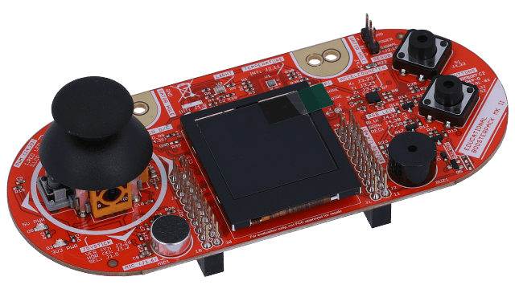
Part 2: LCD Display
BoosterPack MKII
Various cities
FSM
Room Temperature
The Boosterpack MKII is used to display the data using the LCD screen and the push buttons.
The supported cities are currently Rome, Moscow, New york and Tokyo.
C
Current temperature sensing is also implemented.
A finite state machine is used to update the screen on each button press.

Slide 5
PROBLEMS ENCOUNTERED
Compatibility between modules
API related handling
String parsing

Slide 6
POSSIBLE IMPROVEMENTS
Allow the user choose/add cities to display
Show local time
Add other weather related data

